Slide 1
Literary Lenses
One Text – Many Ways of Seeing It

Slide 2
Literary Lenses are
Tools for analysis to understand, evaluate
and interpret texts by reading
with a particular focus.
Also Known As
  Literary Theory
  Critical Theory
  Interpretive Theory

Slide 3
Why are Lenses Important?
By focusing our reading attention on different parts of the text, we can move closer to understanding the text’s theme
Remember that theme is the author’s comment on the human condition!

Slide 4




Slide 5
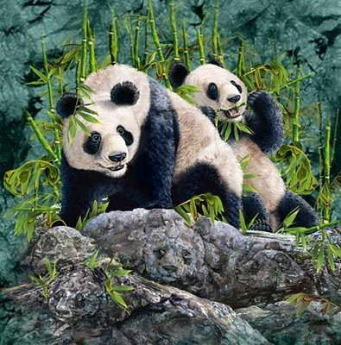
How Many Pandas Do You See?

Slide 6
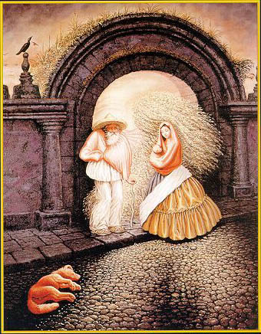
What Do You See?

Slide 7

Nice Vase…Ehh?

Slide 8
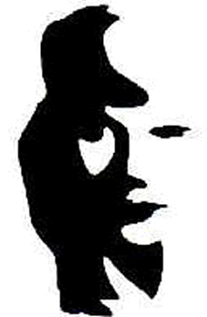
Woman in White?

Slide 9
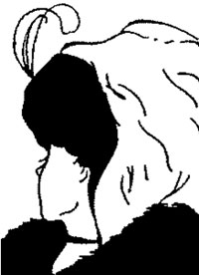
Where is this young woman looking?

Slide 10
Back to Literary Lenses!
So what is the point?
Do we ALL see literature (or anything else we read) the same way?
What evidence do you have of your thoughts to the above question?

Slide 11
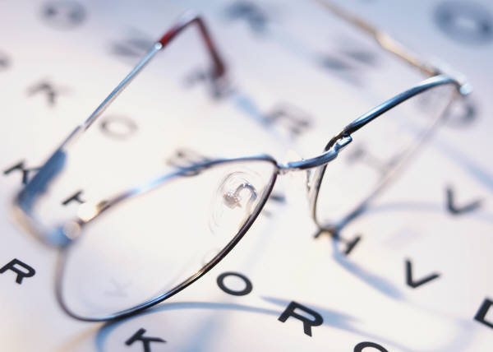
Types of Literary Lenses
Historical
Feminist
Marxist/Sociological
Archetypal/Mythological
Psychological

Slide 12

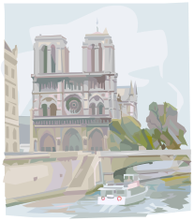

Historical
Looking at a text by investigating the social, intellectual context that produced it, including the author’s biography.
  The Crucible - Cold War
  Of Mice and Men - The Great Depression
Goal is to examine the effect of the work upon its original audience.

Slide 13


Feminist
Examining how genders in a text reflect or reject the social forces that feed inequality.
Central precept that patriarchal attitudes have resulted in literature full of “male-produced” assumptions
  This may also include other stereotypes.

Slide 14
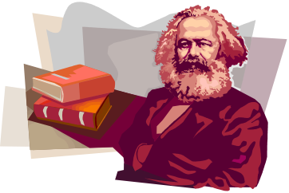

Marxist/Sociological
Looking at a text in terms of power
which is oftentimes related to money
  Who has money; who doesn’t
  Who has power; who doesn’t
  Who is “rich”; who is “poor”

Slide 15
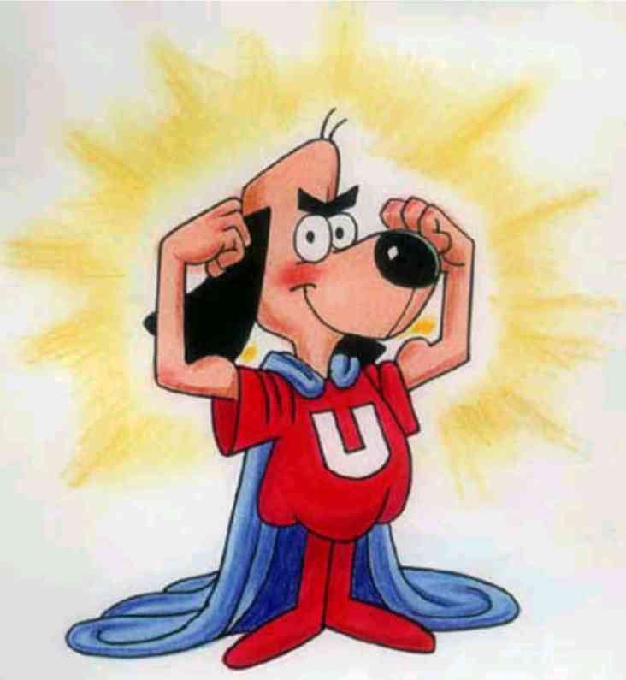
Archetypal/Mythological
Emphasizes the “recurrent universal patterns underlying most literary works”
Common Archetypes
    HERO
    LONER
    VILLIAN
    TEMPTRESS
    SAGE

Slide 16
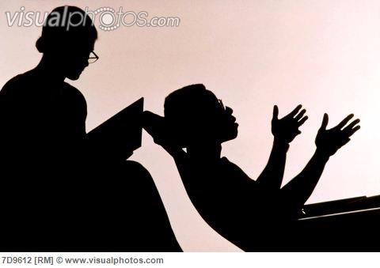
Psychological Approach
Uses the study of the mind and behavior to view a character (or sometimes the author)
Asks
“Why is the character feeling this way?”
“Why does the character behave this way?”
“What motivates these emotions and actions?”

Slide 17
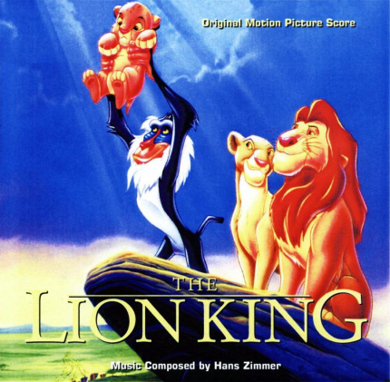
Example to Ponder -
The Lion King
Historical
  Made in 1990s
  Time of great political upheaval in world
  THEME – “right” governments can overcome adversity?

Slide 18
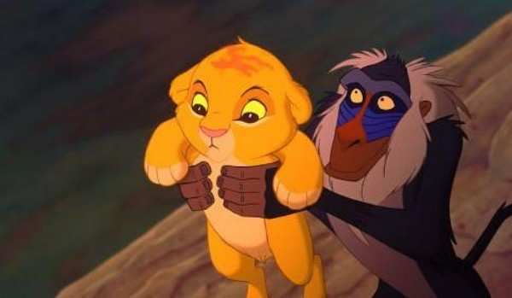
The Lion King
Feminist
  Helpless females
  Females provide food and care for the young yet males have ALL the power
  Nala is stronger than Simba, but she does not inherit the crown
  THEME – Strong men should rule in the world while women support them? Behind every strong man is a stronger woman?

Slide 19
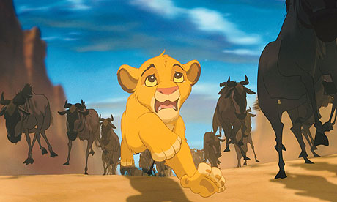
The Lion King
Marxist
  Males have all the power (Mufasa, Simba, Scar)
  When Mufasa dies, Simba is the ONLY one considered for the crown.
  Lions retain power over all other animals
  Hyenas are weak (lower-class)
  Class rebellion leads to the conflict of the film
  THEME – Class distinction should be eliminated?

Slide 20
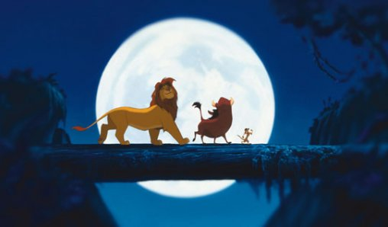
The Lion King
Psychological
  Simba feels undeserving of the kingship because of the guilt he carries regarding Mufasa’s death
  Scar maintains control by fear and violence after killing Mufasa. He had always felt inferior to his brother.
  THEME - Self-respect
  affects one’s ability to
  reach his full potential?

